Slide 1
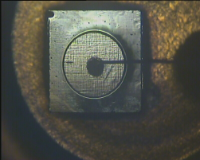

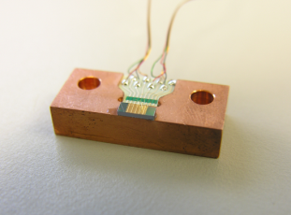
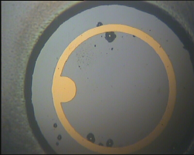
InSb Quantum Dots for High Efficiency mid-IR LEDs
WP4: Materials for Environment Applications
E. Repiso, P. Carrington, A.R.J. Marshall, Q. Lu and A. Krier
Cadiz PROMIS Workshop
18-20 May 2016

Slide 2
Outline
Challenges in the Mid-infrared; 3.3 and 4.2 μm
Proposal: InSb Quantum Dots
MBE growth
PL and EL studies
Summary

Slide 3
Challenges in the Mid-infrared
Lattice matching of the active region
No Semi-insulating substrates
Inadequate electrical confinement; small band offset
Imbalance in the DOS
Leakage current; surface and bulk
Inter-valence band absorption
Auger
  CHCC
  CHSH
Shockley-Read-Hall; native defects or dislocations
Extraction efficiency (~1%)
CB
1
E_{g}
2
HH
Δ₀
1’
LH
SO
Notes:
In III-V semiconductors the heavy hole valence mass, m_{h}, is an order of magnitude greater than the electron mass, m_{e}
Alternatively in narrow gap materials, the electron mass is small. Subsequently there is a small k transfer, with holes close to k=0 (i.e. with low energy) more likely to be occupied.
An Auger process involves the transfer of energy supplied by recombination of an electron hole pair, to a third particle, exciting it to a higher energy state which then subsequently loses the energy non-radiatively

Slide 4
Challenges in the Mid-infrared
Lattice matching of the active region
No Semi-insulating substrates
Inadequate electrical confinement; small band offset
Imbalance in the DOS
Leakage current; surface and bulk
Inter-valence band absorption
Auger
  CHCC
  CHSH
Shockley-Read-Hall; native defects or dislocations
Extraction efficiency (~1%)
CB
3’
1
3
E_{g}
2
HH
Δ₀
LH
SO
Notes:
In III-V semiconductors the heavy hole valence mass, m_{h}, is an order of magnitude greater than the electron mass, m_{e}
Alternatively in narrow gap materials, the electron mass is small. Subsequently there is a small k transfer, with holes close to k=0 (i.e. with low energy) more likely to be occupied.
An Auger process involves the transfer of energy supplied by recombination of an electron hole pair, to a third particle, exciting it to a higher energy state which then subsequently loses the energy non-radiatively

Slide 5
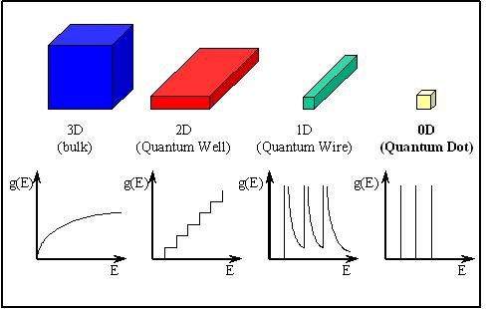
Approaches: Quantum Dots
DH
QW
QD
δ-like density of states; more confinement.
Temperature insensitive.
Avoid lattice mismatch.
Have shown promising results at shorter wavelengths.
Notes:
An alternative approach is to use Quantum Dots where the discrete density of states could lead to a low threshold current and a less temperature sensitive threshold current or a high characteristic temperature.
Quantum Dots have shown encouraging results at shorter wavelengths and as shown in the figure here the progression via thin films to zero dimensional quantum dots has led to a substantial reduction in the threshold current density of GaAs and InP-based diode lasers.
And we want to try to extend the success of Quantum Dots to the mid-infrared range

Slide 6
Approaches: InSb QDs in InAs
III-V band line-ups
Self organisation is possible due to large enough lattice mismatch, Δa/a = 6.5%
Compresive strain.
Type-II broken gap Band Line-up => Reduced Auger recombination => Higher emission efficiency at room temperature
X
in eV
77 K
0.78
AlSb
GaSb
0.23
InSb
-0.17
-0.03
0
-0.41
InAs
-0.59
InSb
a ~ 6.1Å
6.47Å
E_{C}
Vurgaftman & Meyer, JAP(2001)
185 meV
E_{V}
ΔE_{V}
910 meV
ΔE_{C}
680 meV
-
-
E_{C}
415 meV
+
+
E_{V}
InAs
InAs
Su-Huai Wei, Zunger A., PRB (1995)

Slide 7
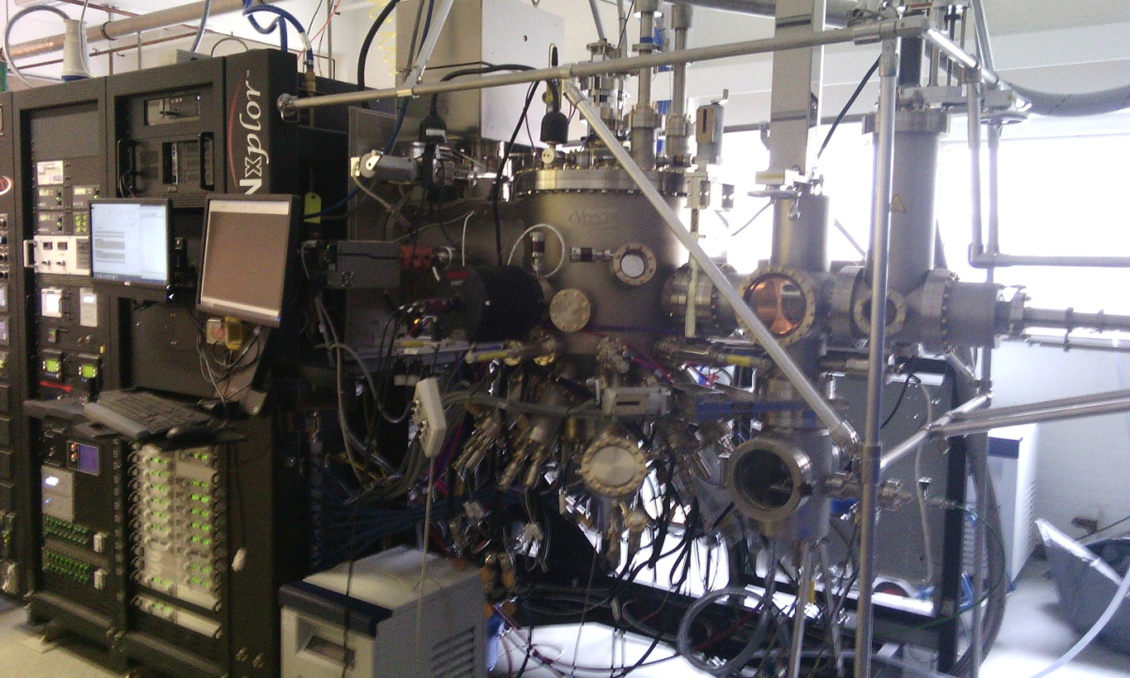
Stranski-Krastanov growth of InSb QDs
In and Sb are large atoms that behave as surfactants. InSb has a low bond energy – high surface mobility of atoms-.
Promote 2D growth rather than 3D.
Tendency to form large clusters of islands.
Low density of dots.
InSb
InAs
Increasing strain
InSb
InAs
Veeco GENxplor
2D Layer growth followed by 3D island growth. Critical thickness = 1.7ML
Notes:
1. InSb grown directly on InAs obeys the SK growth mode where 2D layer growth is followed by 3D island growth to reduce the strain energy as shown in the diagram here. The critical thickness is around 1.7ML.
2. InSb QDs have been grown on InAs using the S-K mode at LPE at Lancaster and more recently at the Ioffe Institute with a density around 10^10 dots and low T PL in the range 3.8-4.3um
3. The AFM picture here shows InSb QDs grown on InAs by LPE at Lancaster where we have a bi-modal distribution of dot sizes
The small QDs are 4nm high, 20nm in diameter with a density around 4*10^10dots/cm^2
The large QDs are 12nm high and 60nm in diameter with a density around 8*10^10dots/cm^2
4. Using MBE, a density up to 8*10^9 has been achieved using ALE with PL at 3.3um at 10K
5. And also by using MBE, Montpellier have reported a density up to 3*10^10 for growth on a thin 1nm InAs layer on GaSb

Slide 8
InSb submonolayer QDs
InSb QDs within ultra-thin InSb layers (0.5-0.9 ML) in InAs have been formed by exposing the growth surface to a Sb flux exploiting an efficient As-Sb exchange: Solov’ev 2005 (MBE)
Sb Flux
As – Sb exchange
As rich surface
InAs
InAs
Notes:
And the As and Sb atoms swap over as such

Slide 9
InSb submonolayer QDs
InSb QDs within ultra-thin InSb layers (0.5-0.9 ML) in InAs have been formed by exposing the growth surface to a Sb flux exploiting an efficient As-Sb exchange: Solov’ev 2005 (MBE)
Sb Flux
As rich surface
InAs
InAs
Dense array of InSb islands partly covering the surface
InAs
Notes:
Which forms a very thin layer of InSb islands partly covering the surface where the integral thickness of InSb deposited is less then 1ML.
This is blow the critical thickness for S-K growth so there is no wetting layer

Slide 10
Extra InSb insertions
To grow larger QDs at high growth temperatures – reduce Sb segregation, better quality material and to avoid long growth interruptions.
A InSb deposition in MEE mode is used following the Sb exchange.
In the insertions thicker than 1 ML, PL intensity drops drastically: growth of relaxed islands.
InAs
Single Sb exchange
Intensity (a.u.)
exchange + MEE
Notes:
1. So to grow bigger QDs at high GT to reduce Sb segregation, for better quality material and to avoid long growth interruptions a short InSb deposition in MEE mode is used following the exchange.
2. The RHEED oscillations for single exchange are here which consists of a 20s Sb exposure followed by a 10s GI then capped with InAs
For thicker insertions following the GI we directly deposit InSb using MEE with a short In deposit, typically 4s and a second Sb Exchange then cap with InAs.
3. PL scans for samples grown using this technique at 430C are shown here
4. And you can see in the samples were the InSb nominal insertion thickness exceeds 1ML the PL intensity drops dramatically corresponding to the growth of relaxed islands. This puts a limit to the maximum InSb thickness using this technique which is still below SK critical thickness
5. And the PL intensity is much higher and narrower for the samples grown using deposition following exchange than for the samples grown using only exchange at the same wavelength.

Slide 11
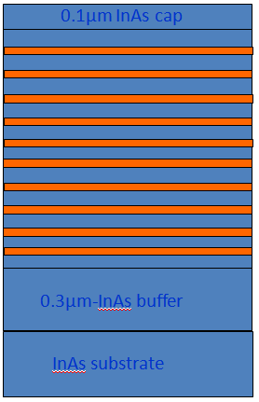
MBE growth and design of InSb/InAs QDs
Samples for PL studies
17.8 nm-InAs barriers
InSb QDs
(0.8ML)

Slide 12
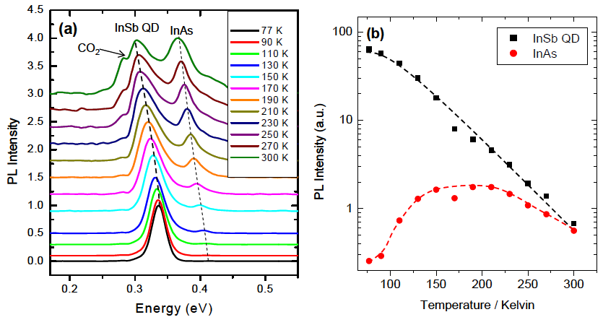

Temperature dependent PL
Temperature dependence:
$$I\left(T\right)=I_{0}e^{−T/T_{c}}$$
The characteristic temperature T_{c} = 109±2 K
Notes:
Here we have the temperatures and power dependent PL scans for the samples. The inset shows the change in the QD energy with Temperature where we see a blue shift between up to 60K. We also see a blue shift with increasing excitation power which is a characteristic of type II arrays. We believe this effect maybe due to electronically coupled dots where the holes are able to migrate from one dot to another due to the high density.

Slide 13
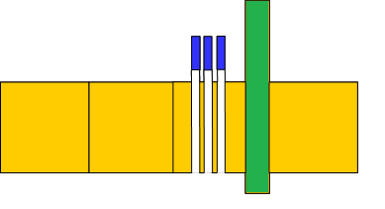
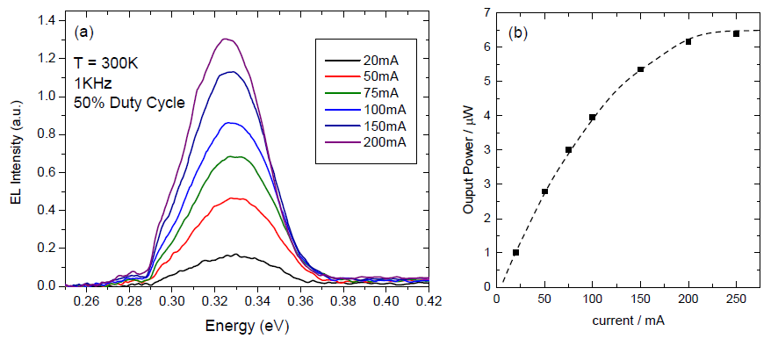

InSb QDs LEDs
0.7ML InSb QD,10 Sheets / 17nm barriers
AlGaAsSb electron
blocking barrier (30nm)
n-InAs
n+ InAs
p+InAs
0.5 µm
0.3 µm
0.5 µm
$Z=$2.4
Notes:
1. Using the exchange + Deposition technique at high temperatures QD Leds were fabricated containing 10 QD sheets with 0.7ML insertion thickness and 17nm InAs barriers.
2. The diodes were grown on n-type InAs substrates with 0.5um doped layers, 0.3um active region and a quaternary AlGaAsSb electron blocking barrier which improves EL intensity by a factor of 5
3. The diodes were processed into 750um mesas with 200um gold contacts and mounted epi-side up onto standard headers.
4. The devices show relatively good IV characteristics with leakage current of 2mA and series resistance of 0.9ohms.

Slide 14
Summary
Successful growth of high density (1·10¹²/cm²) InSb QDs in InAs with excellent crystalline quality and low defect density.
Bright PL up to room temperature with superior quenching compared to bulk InAs.
Room temperature LEDs with dominant radiative recombination, peak at 3.8µm.
Demostrated the potential of type II InSb/InAs QDs for mid-infrared photonic devices.

Slide 15
Thanks for your attention

